Slide 1
School of Computing Science and Engineering
Course Code: BCSE2370
Course Name: Data Communication and Networking
Subject Code: BCSE2370
Subject Name: Data Communication and Networking
Faculty Name: Mr. Suresh Kumar N
Program Name: B.Tech

Slide 2
School of Computing Science and Engineering
Course Code: BCSE2370
Course Name: Data Communication and Networking
COURSE OUTCOMES
On completion of the course, the student will be able to,
CO1. Understand the different networking sub-systems and their functions in a telecommunication system.
CO2. Understand and configure the different types of network topologies and protocols.
CO3. Understand the different protocols layers of the OSI model.
CO4. Examine and analyze the network-layer concepts like Network-Layer services –
Routing -IP protocol -IP addressing.
CO5. Examine and analyze the different link-layer and local area network concepts like Link-Layer services –Ethernet -Token Ring -Error detection and correction -ARP protocol
CO6. Gain understanding of latest trends and research areas in the course
Faculty Name: Mr. Suresh Kumar N
Program Name: B.Tech

Slide 3
School of Computing Science and Engineering
Course Code: BCSE2370
Course Name: Data Communication and Networking
Unit 3
Medium Access sub layer
Faculty Name: Mr. Suresh Kumar N
Program Name: B.Tech

Slide 4
Topics to be covered
Medium Access sub layer
Channel Allocations

Slide 5
Medium Access sub layer
The medium access control (MAC) is a sublayer of the data link layer of the open system interconnections (OSI) reference model for data transmission.
It is responsible for flow control and multiplexing for transmission medium.
It controls the transmission of data packets via remotely shared channels.

Slide 6
Medium Access sub layer
The Open System Interconnections (OSI) model is a layered networking framework that conceptualizes how communications should be done between heterogeneous systems. The data link layer is the second lowest layer. It is divided into two sublayers −
The logical link control (LLC) sublayer
The medium access control (MAC) sublayer

Slide 7
Medium Access sub layer
The Open System Interconnections (OSI) model is a layered networking framework that conceptualizes how communications should be done between heterogeneous systems. The data link layer is the second lowest layer. It is divided into two sublayers −
The logical link control (LLC) sublayer
The medium access control (MAC) sublayer

Slide 8
Medium Access sub layer
It provides an abstraction of the physical layer to the LLC and upper layers of the OSI network.
It is responsible for encapsulating frames so that they are suitable for transmission via the physical medium.
It resolves the addressing of source station as well as the destination station, or groups of destination stations.

Slide 9
Medium Access sub layer
It performs multiple access resolutions when more than one data frame is to be transmitted. It determines the channel access methods for transmission.
It also performs collision resolution and initiating retransmission in case of collisions.
It generates the frame check sequences and thus contributes to protection against transmission errors.

Slide 10
MAC Addresses
MAC address or media access control address is a unique identifier allotted to a network interface controller (NIC) of a device. It is used as a network address for data transmission within a network segment like Ethernet, Wi-Fi, and Bluetooth.
MAC address is assigned to a network adapter at the time of manufacturing. It is hardwired or hard-coded in the network interface card (NIC). A MAC address comprises of six groups of two hexadecimal digits, separated by hyphens, colons, or no separators. An example of a MAC address is 00:0A:89:5B:F0:11.

Slide 11
Channel Allocation
Channel Allocation may be done using two schemes −
Static Channel Allocation
Dynamic Channel Allocation

Slide 12
1. Static Channel Allocation
When there is more than one user who desires to access a shared network channel, an algorithm is deployed for channel allocation among the competing users.
Static channel allocation is a traditional method of channel allocation in which a fixed portion of the frequency channel is allotted to each user, who may be base stations, access points or terminal equipment.
This scheme is also referred to as fixed channel allocation or fixed channel assignment.

Slide 13
1. Static Channel Allocation
Working Principle:
Suppose that there are N competing users.
Here, the total bandwidth is divided into N discrete channels using frequency division multiplexing (FDM).
In most cases, the size of the channels is equal. Each of these channels is assigned to one user.

Slide 14
1. Static Channel Allocation
Advantages:
Static channel allocation scheme is particularly suitable for situations where there are a small number of fixed users having a steady flow of uniform network traffic.
The allocation technique is simple and so the additional overhead of a complex algorithm need not be incurred.
Besides, there is no interference between the users since each user is assigned a fixed channel which is not shared with others.

Slide 15
1. Static Channel Allocation
Disadvantages:
Most real-life network situations have a variable number of users, usually large in number with bursty traffic. If the value of N is very large, the bandwidth available for each user will be very less. This will reduce the throughput if the user needs to send a large volume of data once in a while.
It is very unlikely that all the users will be communicating all the time. However, since all of them are allocated fixed bandwidths, the bandwidth allocated to non-communicating users lies wasted. If the number of users is more than N, then some of them will be denied service, even if there are unused frequencies.

Slide 16
2. Dynamic Channel Allocation
When there are more than one user who desire to access a shared network channel, an algorithm is deployed for channel allocation among the competing users.
Dynamic channel allocation encompasses the channel allocation schemes where channels are allotted to users dynamically as per their requirements, from a central pool.

Slide 17
2. Dynamic Channel Allocation
Working Principle:
In dynamic channel allocation schemes, frequency channels are not permanently allotted to any user.
Channels are assigned to the user as needed depending upon the network environment.
The available channels are kept in a queue or a spool. The allocation of the channels is temporary.
Distribution of the channels to the contending users is based upon distribution of the users in the network and offered traffic load. The allocation is done so that transmission interference is minimized.

Slide 18
2. Dynamic Channel Allocation
The dynamic channel allocation schemes can be divided into three categories −
Interference Adaptive Dynamic Channel Allocation (IA-DCA)
Location Adaptive Dynamic Channel Allocation (LA-DCA)
Traffic Adaptive Dynamic Channel Allocation (TA-DCA)
All these schemes evaluate the cost of using each available channel and allocates the channel with the optimum cost.

Slide 19
2. Dynamic Channel Allocation
Advantages:
Dynamic channel allocation schemes allots channels as needed. This results in optimum utilization of network resources.
There are less chances of denial of services and call blocking in case of voice transmission. These schemes adjust bandwidth allotment according to traffic volume, and so are particularly suitable for bursty traffic.

Slide 20
2. Dynamic Channel Allocation
Disadvantages:
Dynamic channel allocation schemes increases the computational as well as storage load on the system.

Slide 21
Summary
Medium Access sub layer
Channel Allocations

Slide 22
Topics to be covered
LAN protocols
ALOHA protocols
Overview of IEEE standards
FDDI

Slide 23
LAN protocols
A LAN is a high-speed, fault-tolerant data network that covers a relatively small geographic area.
It typically connects workstations, personal computers, printers, and other devices.
LANs offer computer users many advantages, including shared access to devices and applications, file exchange between connected users, and communication between users via electronic mail and other applications

Slide 24
LAN protocols
"Ethernet" is by far the most common type of LAN protocol. It is found in homes and offices throughout the world and is recognizable by its common "CAT5" copper cable medium. It uses a switch or hub to which all systems connect to exchange data.
"Token Ring" is an older LAN technology that is not prevalent anymore. The basic premise of "Token Ring" is a single "token" is passed from system to system, or through a hub, and only the intended recipient reads the token.
"FDDI" defines how LAN traffic is transmitted over fiber cabling. Fiber cabling is used when longer distances, usually between floors or buildings, are required, or where heightened security is required.

Slide 25
ALOHA Protocol
It is designed for wireless LAN (Local Area Network) but can also be used in a shared medium to transmit data. Using this method, any station can transmit data across a network simultaneously when a data frameset is available for transmission.

Slide 26
ALOHA Rules
Any station can transmit data to a channel at any time.
It does not require any carrier sensing.
Collision and data frames may be lost during the transmission of data through multiple stations.
Acknowledgment of the frames exists in Aloha. Hence, there is no collision detection.
It requires retransmission of data after some random amount of time.

Slide 27
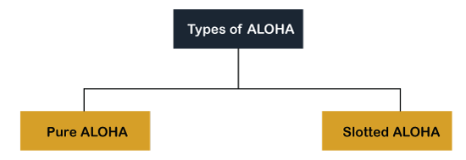
ALOHA Protocol

Slide 28
1. Pure Aloha
Whenever data is available for sending over a channel at stations, we use Pure Aloha. In pure Aloha, when each station transmits data to a channel without checking whether the channel is idle or not, the chances of collision may occur, and the data frame can be lost.
When any station transmits the data frame to a channel, the pure Aloha waits for the receiver's acknowledgment. If it does not acknowledge the receiver end within the specified time, the station waits for a random amount of time, called the backoff time (Tb). And the station may assume the frame has been lost or destroyed.
Therefore, it retransmits the frame until all the data are successfully transmitted to the receiver.

Slide 29
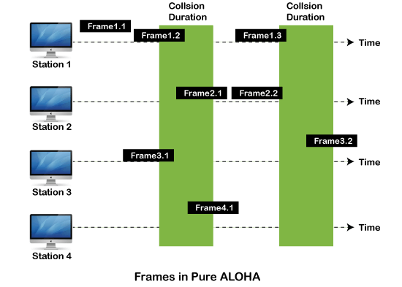
1. Pure Aloha

Slide 30
2. Slotted Aloha
The slotted Aloha is designed to overcome the pure Aloha's efficiency because pure Aloha has a very high possibility of frame hitting.
In slotted Aloha, the shared channel is divided into a fixed time interval called slots.
So that, if a station wants to send a frame to a shared channel, the frame can only be sent at the beginning of the slot, and only one frame is allowed to be sent to each slot. And if the stations are unable to send data to the beginning of the slot, the station will have to wait until the beginning of the slot for the next time.
However, the possibility of a collision remains when trying to send a frame at the beginning of two or more station time slot.

Slide 31
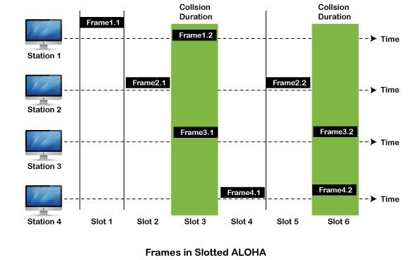
2. Slotted Aloha

Slide 32
Overview of IEEE standards
The IEEE standards in computer networks ensure communication between various devices; it also helps to make sure that the network service, i.e., the Internet and its related technologies, must follow a set of guidelines and practices so that all the networking devices can communicate and work smoothly.

Slide 33
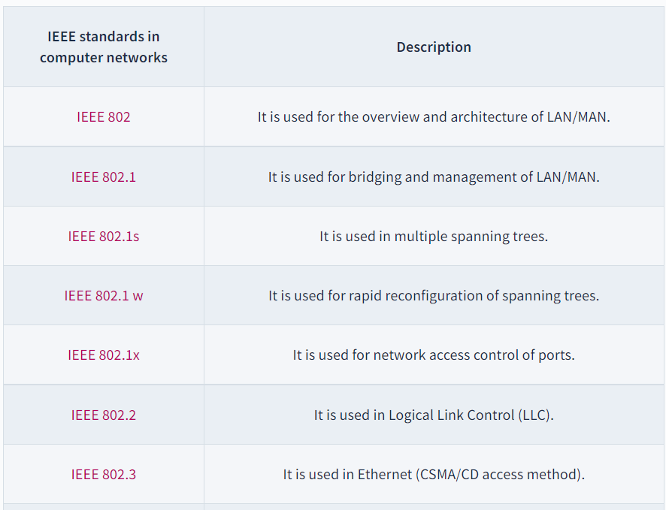
Overview of IEEE standards

Slide 34
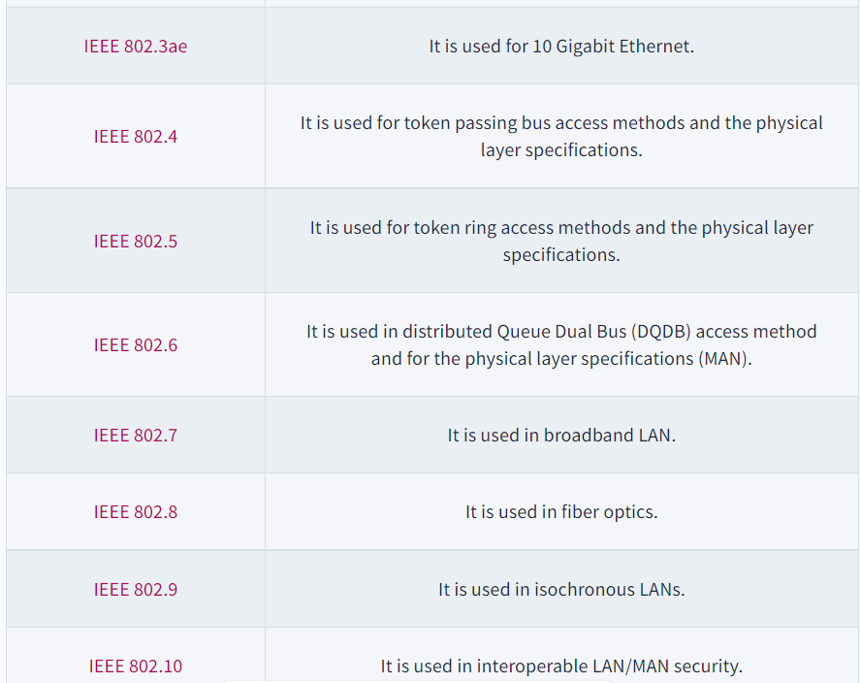
Overview of IEEE standards

Slide 35
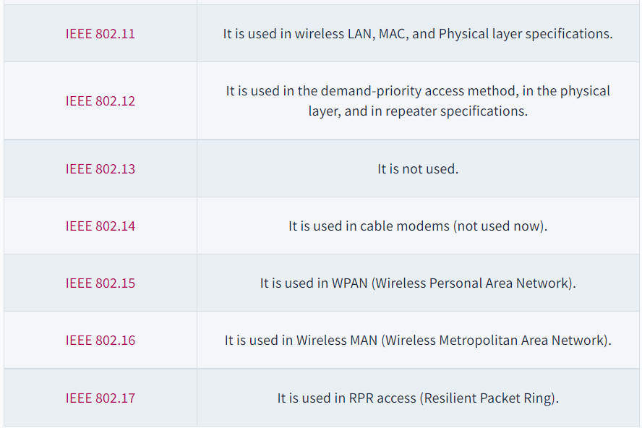
Overview of IEEE standards

Slide 36
FDDI
FDDI stands for Fiber Distributed Data Interface. It is a set of ANSI and ISO guidelines for information transmission on fiber-optic lines in Local Area Network (LAN) that can expand in run upto 200 km (124 miles). The FDDI convention is based on the token ring protocol.
In expansion to being expansive geographically, an FDDI neighborhood region arranges can support thousands of clients. FDDI is habitually utilized on the spine for a Wide Area Network(WAN).

Slide 37
Characteristics of FDDI
FDDI gives 100 Mbps of information throughput.
FDDI incorporates two interfaces.
It is utilized to associate the equipment to the ring over long distances.
FDDI could be a LAN with Station Management.
Allows all stations to have broken even with the sum of time to transmit information.
FDDI defines two classes of traffic viz. synchronous and asynchronous.

Slide 38
Advantages of FDDI
Fiber optic cables transmit signals over more noteworthy separations of approximately 200 km.
It is conceivable to supply the need to the work stations associated within the chain. Consequently, based on the prerequisite a few stations are bypassed to supply speedier benefit to the rest. FDDI employments different tokens to make strides organize speed.
It offers a higher transmission capacity (up to 250 Gbps). Thus, it can handle information rates up to 100 Mbps. It offers tall security because it is troublesome to spy on the fiber-optic link.
Fiber optic cable does not break as effectively as other sorts of cables.

Slide 39
Disadvantages of FDDI
FDDI is complex. Thus establishment and support require an incredible bargain of expertise.
FDDI is expensive. Typically since fiber optic cable, connectors and concentrators are exceptionally costly.

Slide 40
Summary
LAN protocols
ALOHA protocols
Overview of IEEE standards
FDDI

Slide 41
Topics to be covered
Elementary Data Link Protocols
Sliding Window Protocol

Slide 42
Elementary Data Link Protocols
Protocols in the data link layer are designed so that this layer can perform its basic functions: framing, error control and flow control.
Framing is the process of dividing bit - streams from physical layer into data frames whose size ranges from a few hundred to a few thousand bytes.
Error control mechanisms deals with transmission errors and retransmission of corrupted and lost frames.
Flow control regulates speed of delivery and so that a fast sender does not drown a slow receiver.

Slide 43
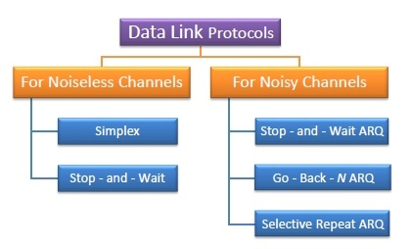
Types of Data Link Protocols
Data link protocols can be broadly divided into two categories, depending on whether the transmission channel is noiseless or noisy.

Slide 44
Simplex Protocol
The Simplex protocol is hypothetical protocol designed for unidirectional data transmission over an ideal channel, i.e. a channel through which transmission can never go wrong.
It has distinct procedures for sender and receiver.
The sender simply sends all its data available onto the channel as soon as they are available its buffer.
The receiver is assumed to process all incoming data instantly.
It is hypothetical since it does not handle flow control or error control.

Slide 45
Stop – and – Wait Protocol
Stop – and – Wait protocol is for noiseless channel too.
It provides unidirectional data transmission without any error control facilities.
However, it provides for flow control so that a fast sender does not drown a slow receiver. The receiver has a finite buffer size with finite processing speed.
The sender can send a frame only when it has received indication from the receiver that it is available for further data processing.

Slide 46
Stop – and – Wait ARQ
Stop – and – wait Automatic Repeat Request (Stop – and – Wait ARQ) is a variation of the above protocol with added error control mechanisms, appropriate for noisy channels.
The sender keeps a copy of the sent frame. It then waits for a finite time to receive a positive acknowledgement from receiver.
If the timer expires or a negative acknowledgement is received, the frame is retransmitted.
If a positive acknowledgement is received then the next frame is sent.

Slide 47
Go – Back – N ARQ
Go – Back – N ARQ provides for sending multiple frames before receiving the acknowledgement for the first frame.
It uses the concept of sliding window, and so is also called sliding window protocol.
The frames are sequentially numbered and a finite number of frames are sent.
If the acknowledgement of a frame is not received within the time period, all frames starting from that frame are retransmitted.

Slide 48
Selective Repeat ARQ
This protocol also provides for sending multiple frames before receiving the acknowledgement for the first frame.
However, here only the erroneous or lost frames are retransmitted, while the good frames are received and buffered.

Slide 49
Sliding Window Protocol
Sliding window protocols are data link layer protocols for reliable and sequential delivery of data frames.
The sliding window is also used in Transmission Control Protocol.
In this protocol, multiple frames can be sent by a sender at a time before receiving an acknowledgment from the receiver.
The term sliding window refers to the imaginary boxes to hold frames. Sliding window method is also known as windowing.

Slide 50
Example
Suppose that we have sender window and receiver window each of size 4. So the sequence numbering of both the windows will be 0,1,2,3,0,1,2 and so on.
The following diagram shows the positions of the windows after sending the frames and receiving acknowledgments.

Slide 51
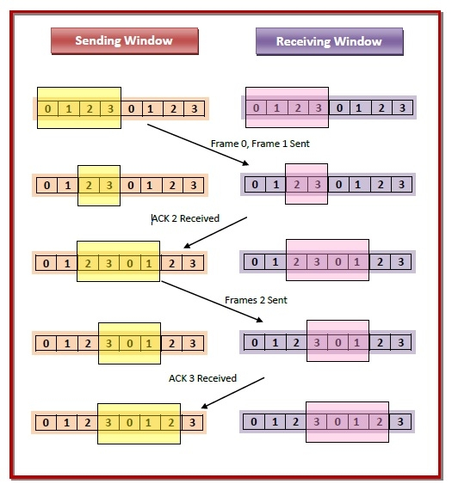
Example

Slide 52
Types of Sliding Window Protocols
1. Go – Back – N ARQ
Go – Back – N ARQ provides for sending multiple frames before receiving the acknowledgment for the first frame.
It uses the concept of sliding window, and so is also called sliding window protocol.
The frames are sequentially numbered and a finite number of frames are sent.
If the acknowledgment of a frame is not received within the time period, all frames starting from that frame are retransmitted.

Slide 53
Types of Sliding Window Protocols
2. Selective Repeat ARQ
This protocol also provides for sending multiple frames before receiving the acknowledgment for the first frame.
However, here only the erroneous or lost frames are retransmitted, while the good frames are received and buffered.

Slide 54
Summary
Elementary Data Link Protocols
Sliding Window Protocol

Slide 55
Topics to be Covered
Error Detection and Correction:
Block coding
cyclic codes
Linear block codes
checksum

Slide 56
Error Detection and Correction: Block coding
In block coding, we divide our message into blocks, each of k bits, called data words. We add r redundant bits to each block to make the length n = k + r. The resulting n-bit blocks are called code words.
For example, we have a set of data words, each of size k, and a set of code words, each of size of n. With k bits, we can create a combination of 2k data words, with n bits; we can create a combination of 2n code words. Since n > k, the number of possible code words is larger than the number of possible data words.

Slide 57
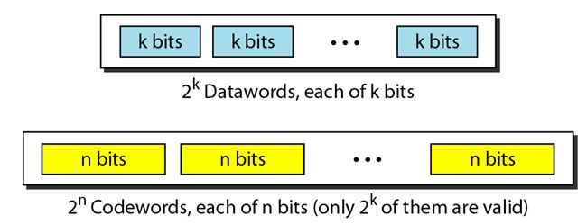
Error Detection and Correction: Block coding
The block coding process is one-to-one; the same data word is always encoded as the same code word. This means that we have 2n-2k code words that are not used. We call these code words invalid or illegal. The following figure shows the situation.

Slide 58
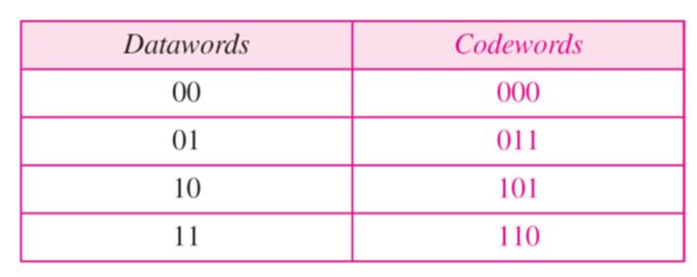
Error Detection and Correction: Block coding

Slide 59
Error Detection and Correction: Block coding
Assume the sender encodes the data word 01 as 011 and sends it to the receiver. Consider the following cases:
1. The receiver receives O11. It is a valid code word. The receiver extracts the data word 01 from it.
2. The code word is corrupted during transmission, and 111 is received (the leftmost bit is corrupted). This is not a valid code word and is discarded.
3. The code word is corrupted during transmission, and 000 is received (the right two bits are corrupted). This is a valid code word. The receiver incorrectly extracts the data word 00. Two corrupted bits have made the error undetectable.

Slide 60
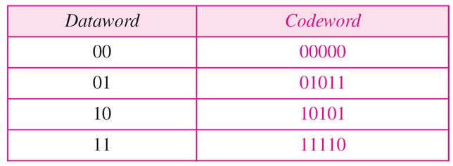
Error Detection and Correction: Block coding
Error correction is much more difficult than error detection. In error detection, the receiver needs to know only that the received code word is invalid, in error correction the receiver needs to find (or guess) the original code word sent. So, we need more redundant bits for error correction than for error detection.

Slide 61
Error Detection and Correction: Cyclic Code
The cyclic property of code words is that any cyclic-shift of a code word is also a code word. Cyclic codes follow this cyclic property.
For a linear code C, if every code word i.e., C = C1,C2,......Cn from C has a cyclic right shift of components, it becomes a code word. This shift of right is equal to n-1 cyclic left shifts. Hence, it is invariant under any shift. So, the linear code C, as it is invariant under any shift, can be called as a Cyclic code.

Slide 62
Error Detection and Correction: Cyclic Code
Cyclic codes are used for error correction.
They are mainly used to correct double errors and burst errors.
Hence, these are a few error correcting codes, which are to be detected at the receiver.
These codes prevent the errors from getting introduced and disturb the communication. They also prevent the signal from getting tapped by unwanted receivers.
There is a class of signaling techniques to achieve this, which are discussed in the next chapter.

Slide 63
Error Detection and Correction: Linear Block Codes
In the linear block codes, the parity bits and message bits have a linear combination, which means that the resultant code word is the linear combination of any two code words.
Let us consider some blocks of data, which contains k bits in each block. These bits are mapped with the blocks which has n bits in each block. Here n is greater than k. The transmitter adds redundant bits which are n−k bits. The ratio k/n is the code rate. It is denoted by r and the value of r is r < 1.

Slide 64
Error Detection and Correction: Linear Block Codes
The n−k bits added here, are parity bits. Parity bits help in error detection and error correction, and also in locating the data. In the data being transmitted, the left most bits of the code word correspond to the message bits, and the right most bits of the code word correspond to the parity bits.

Slide 65
Error Detection and Correction: checksum
For error detection by checksums, data is divided into fixed sized frames or segments.
Sender’s End − The sender adds the segments using 1’s complement arithmetic to get the sum. It then complements the sum to get the checksum and sends it along with the data frames.
Receiver’s End − The receiver adds the incoming segments along with the checksum using 1’s complement arithmetic to get the sum and then complements it.
If the result is zero, the received frames are accepted; otherwise they are discarded.

Slide 66
Error Detection and Correction: checksum
Suppose that the sender wants to send 4 frames each of 8 bits, where the frames are 11001100, 10101010, 11110000 and 11000011.
The sender adds the bits using 1s complement arithmetic. While adding two numbers using 1s complement arithmetic, if there is a carry over, it is added to the sum.
After adding all the 4 frames, the sender complements the sum to get the checksum, 11010011, and sends it along with the data frames.
The receiver performs 1s complement arithmetic sum of all the frames including the checksum. The result is complemented and found to be 0. Hence, the receiver assumes that no error has occurred.

Slide 67
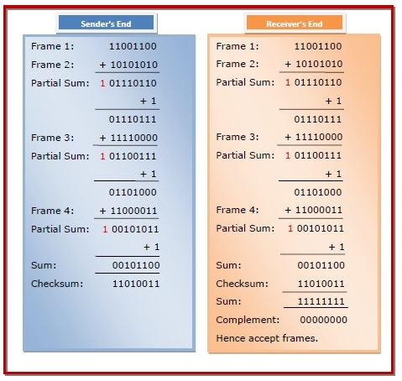
Error Detection and Correction: checksum

Slide 68
Summary
Error Detection and Correction:
Block coding
cyclic codes
Linear block codes
checksum

Slide 69
References
Forouzan, Data Communications and Networking, McGraw Hill, 4th ed.
Tannenbaum, Computer Networks, Pearsoned Education.

Slide 70
Contact
N.Suresh Kumar
School of Computing Science and Engineering
Assistant Professor
Galgotias University
Email: sureshkumar@galgotiasunviersity.edu.in
Mobile: + 91 80567 44016

Slide 71
GALGOTIAS UNIVERSITY
THANK YOU

